Slide 1
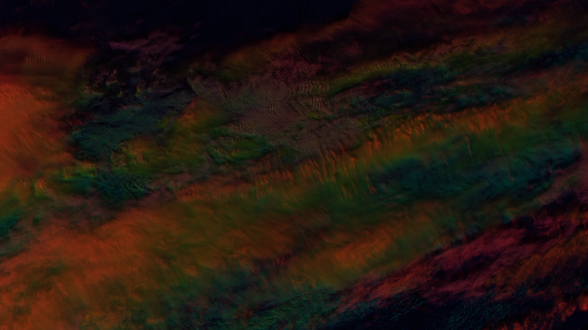
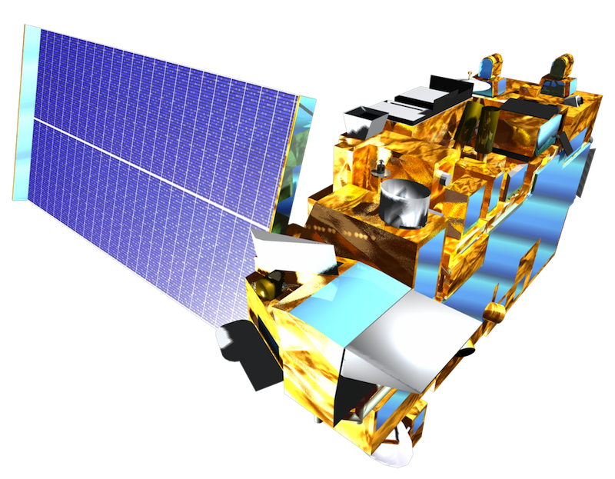

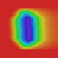
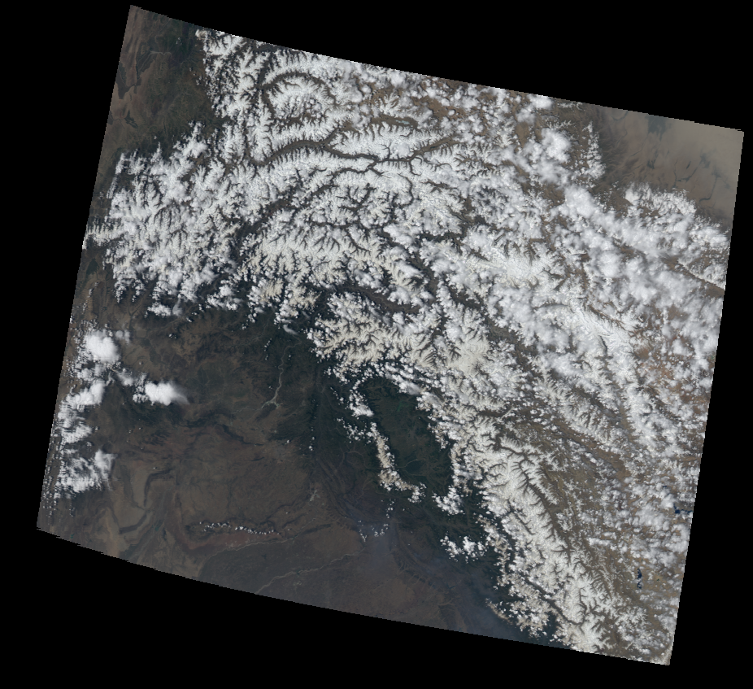
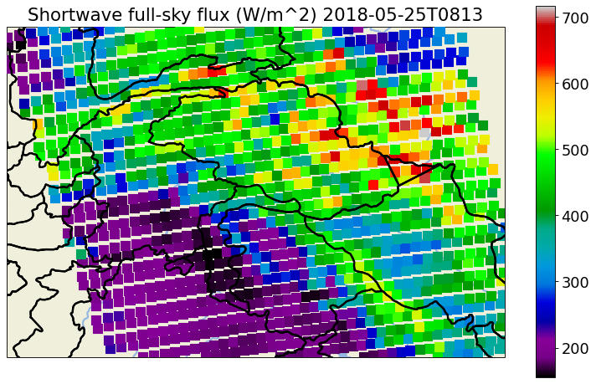
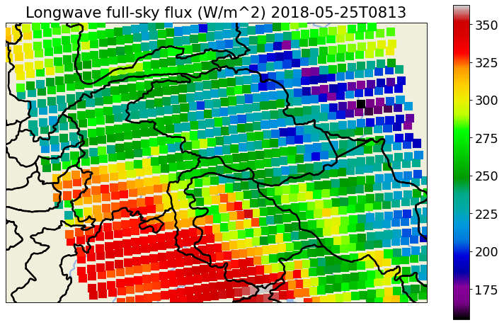
True Color
R:.64um G:.55um B:.45um
A Deep Learning approach to Estimate CERES Broadband Flux with 1km MODIS Pixels.
NASA EOS
Terra or Aqua
SZA
AES 690 - Project Update 2 - Mitchell Dodson
Goal: develop a data-driven deep learning model to characterize the relationship between EOS-MODIS’ 36 spectral radiance bands, the sun/pixel/satellite viewing geometry, and the full-sky broadband radiative flux observed by the EOS-CERES instrument over a diverse set of regions.
VZA
CERES SW
CERES LW
MODIS
Radiance
W
W

Slide 2
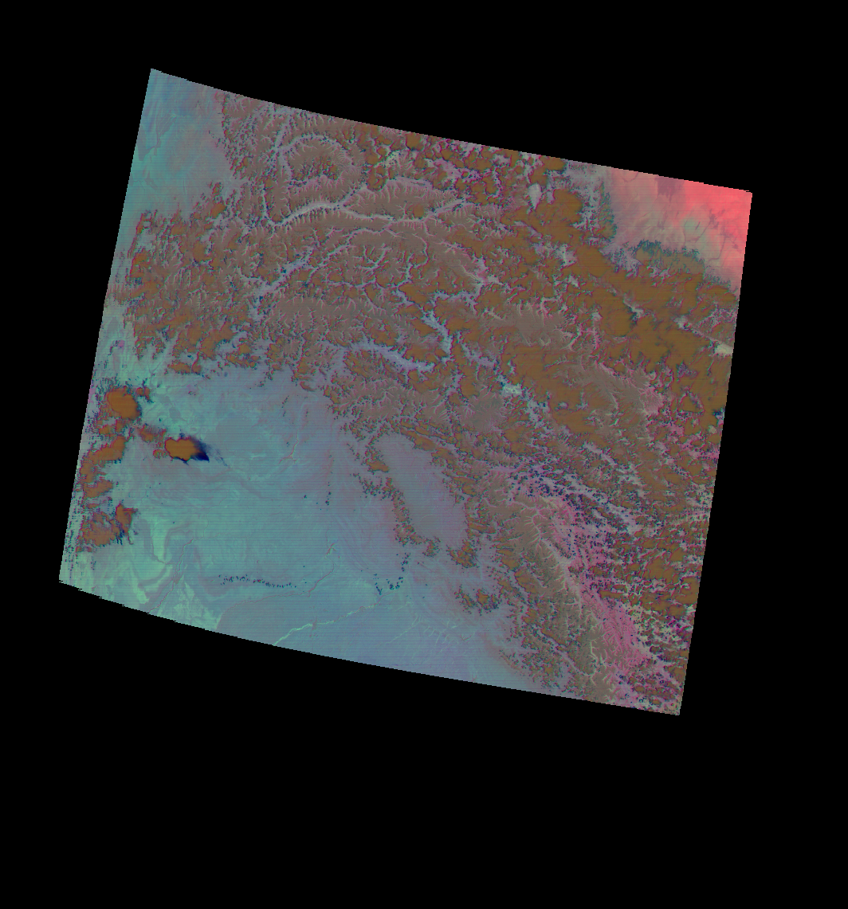
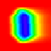
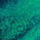
Key:
Download:
Generate:
Utilize:
Call:
Data pipeline overview:
Use the LARC downloader to acquire CERES SSF data over a series of desired regions and time periods.
LARC
CERES
netCDF4s
1
Download CERES-SSF E4A data from LARC
2
Select fields, restrict valid viewing geometry, and apply other constraints, then call get_ceres_swath.py, which extracts, subsets, and preprocesses CERES footprints, then groups them into individual overpasses per region and satellite. These are stored with their meta-info in a new pickle file.
get_ceres_swath.py
Download MODIS overpasses from LAADS
CERES
swath
pkls
acquire_laads.py
3
Select a series of MODIS bands to extract, and set file storage parameters in get_modis_swath.py, then run the script to download MxD021KM and MxD03 L1b granules from LAADS corresponding to each swath. Extract the desired bands in range of the CERES data, and combine the MODIS and CERES data for each overpass in a custom ‘swath’ HDF5.
plot_ceres.py
get_modis_swath.py
LAADS
MODIS
HDF4s
geom_utils.py
plot_modis.py
combined
swath
HDF5s
generate_samples.py
4
generate_samples.py loads several swath HDF5s concurrently, extracts CERES footprints and surrounding MODIS tiles, then calculates the CERES point spread function over each sub-domain. Samples from the loaded swaths’ PSFs, MODIS/CERES data, and viewing geometry are interleaved and yielded as tensors.
Generates:
PSF: (B,W,W,1)
MODIS: (B,W,W,F_{M})
Geometry: (B,1,1,F_{G})
CERES: (B,1,1,F_{C})
B:batch W:width F_{x}:features

Slide 3
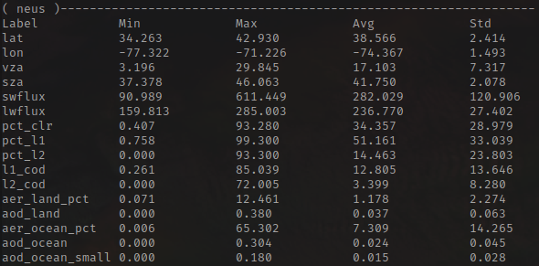
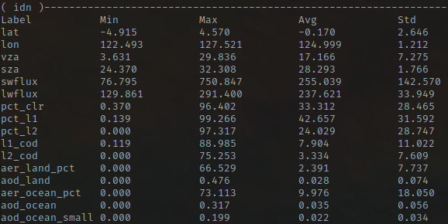
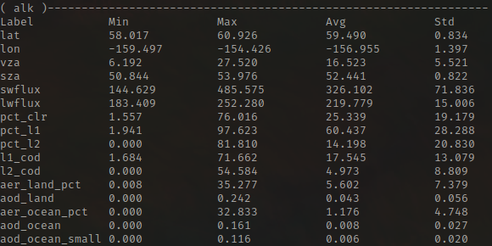
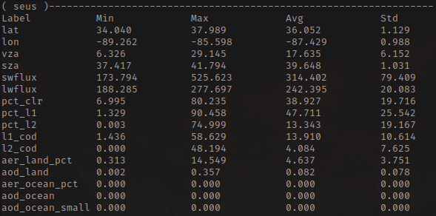
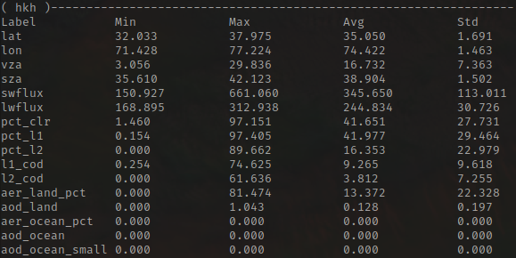
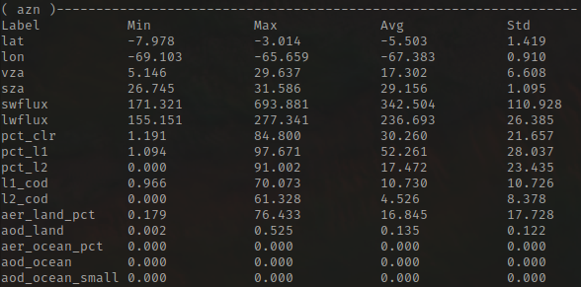
Acquired regional data:
Using the described data pipeline, I acquired every third available EOS Terra and Aqua swath in the 3 years between Jan 1, 2018 and Dec 31, 2020, within the regional boundaries described below, for a total of about 2,600 overpasses, each of which contain about 300 individual samples on average.
Northeast United States
lat ∈ [34,43] lon ∈ [-69,-79]
Swath count: 532
Indonesia
lat ∈ [-5,5] lon ∈ [120,130]
Swath count: 493
Alaska
lat ∈ [58,61] lon ∈ [-160,-154]
Swath count: 383
Southeast United States
lat ∈ [34,38] lon ∈ [-90,-85]
Swath count: 356
Hindu Kush Himalayas
lat ∈ [32,38] lon ∈ [69,79]
Swath count: 520
Amazon Rainforest
lat ∈ [-3,-8] lon ∈ [-65,-70]
Swath count: 305

Slide 4
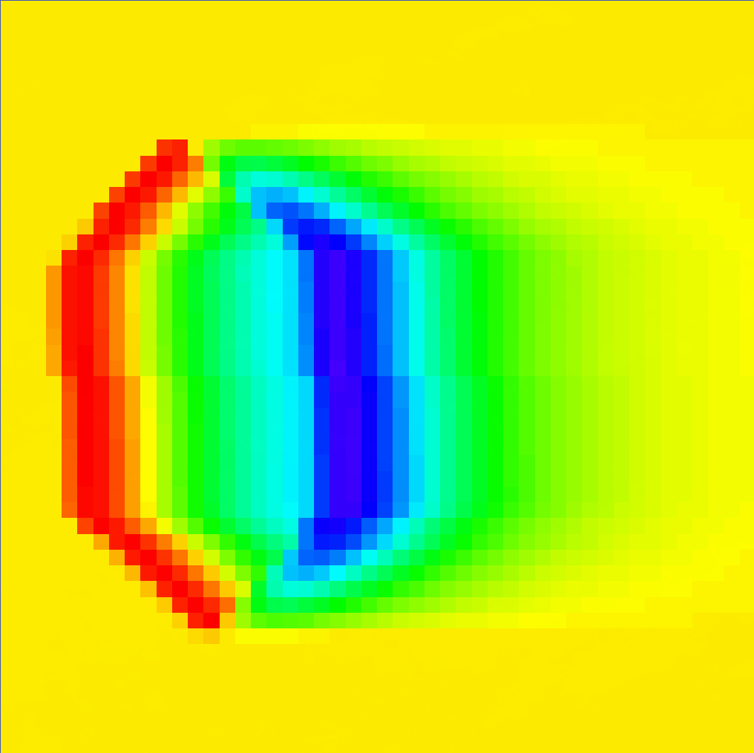
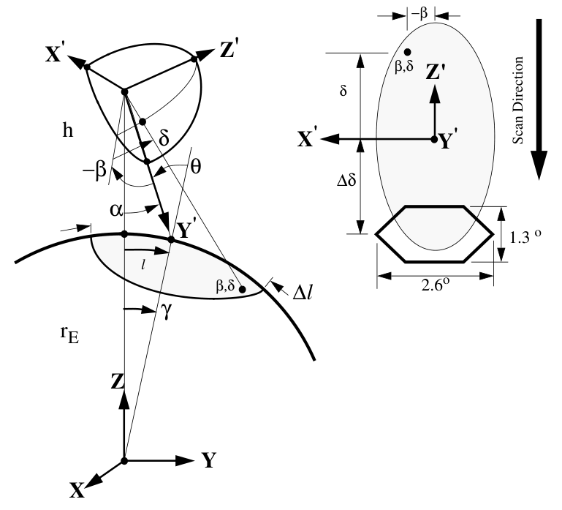
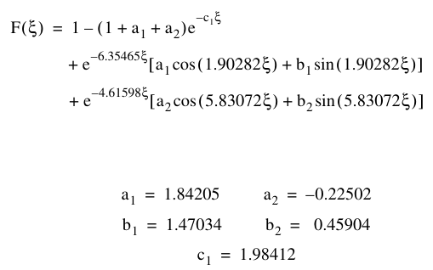
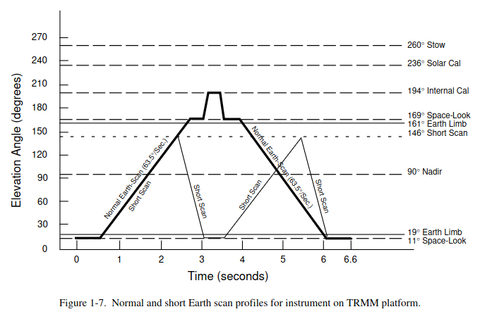
Challenge: Point Spread Function
Faulty PSF
Corrected PSF
negative
Equatorial geometry of the observation, and MODIS/CERES centroid offset schematic
Implementing the CERES point spread function (PSF) over the co-located MODIS domain has presented a major development challenge. The algorithm to do so is specified in CERES ATBD subsystem 4.4, which I vectorized and implemented in generate_samples.py and geom_utils.py.
One issue I encountered is that the analytic equation approximating the PSF (specified to the right) was producing a result with very negative values near the aft border of the oblong CERES centroid.
I found that the cause of the error was that the ‘xi’ angle in the formula is assumed to be in radians rather than degrees, despite having been bounded and scaled previously by values in degrees.
CERES centroid
cone angle
Empirical convolution equation
(silently given in radians)
MODIS centroid
CERES’ alternating scan direction
One related challenge that is still yet to be resolved is that the orientation of the MODIS grid centroid relative to the CERES footprint centroid is determined by the time derivative of CERES’ cross-track scan elevation α (satellite viewing cone angle), which alternates between cross-track sweeps, as diagrammed by the figure to the right.
Despite being specified in the ATBD, the derivative quantity isn’t included in the CERES SSF data product. Since the above geometry is entirely calculated from relative geodetic values, it also cannot be directly inferred from the data.

Slide 5
The next steps:
Model training plan:
First, do a broad random search of model hyper- -parameters on the simplest possible task (ie, a single region/season/satellite combination)
Then, using the most promising learning rate schedule and regularization method:
Train a large and small model on each individual region, using only one satellite.
Train a large and small model combining all swaths, seasons, and satellites.
Finally, evaluate each of the models on unseen data from all of the input sub-populations.
Data Source:
The data tensors yielded by generate_samples.gen_swaths_samples
are structured as tuples: ((M, G, P), C), each containing B batch samples:
M := (B,W,W,F_{M}) MODIS reflectance or brightness temperature in F_{M} bands
G := (B,1,1,F_{G}) Full-footprint viewing geometry F_{G}:=(sol_zen, sat_zen, rel_azi)
P := (B,W,W,1 ) 2D PSF probability distribution over the MODIS domain
C := (B,1,1,F_{C}) CERES footprint over the MODIS domain F_{C}:=(lw_flux, sw_flux)
The generator also provides options for linear normalization,
and for constraining the parameters and sources of the data it returns.
The full dataset includes observations from 2 different sensors, which were collected over 6 distinct regions having widely varying characteristics.
These statistical sub-populations may make the flux prediction significantly more complex, so I will train separate models using stratified sampling techniques on subsets of the data.
The basic model architecture consists of a sequence of 1D convolutions over the MODIS pixels to produce an independent latent representation of the radiance. The latent domain is concatenated with the viewing geometry (which is the same for all the pixels). Next, a second sequence of pixel-wise convolutional layers decodes the intermediate data to pixel-wise SW/LW predictions. Finally, the predictions are aggregated by a weighted sum over the PSF, and the loss is calculated with the result relative to the CERES footprints over the domain.
If time allows, I will experiment with applying the PSF aggregation to the latent grid before concatenating the resulting vector with the viewing geometry, and decoding with a simple multi-layer perceptron.
Since the entire model is pixel-wise, the full range of its predictions can be evaluated by modulating a single vector of input features. As such, it will also be interesting to see how predictions change with respect to the viewing geometry and MODIS spectral response.
Base Model Architecture:
L_{D} and L_{E} are pixel-wise
convolution layers.
Divergence:
D = (P - F_{C})²
Predicted P_{SW} P_{LW}
Shape: (B,1,1,F_{C})
PSF
(MultSum P)
Sharpened SW/LW
Shape: (B,W,W,F_{C})
SW LW
×L_{D} Decoder
(1D Conv)
Latent grid Z
Shape: (B,W,W,F_{L})
Z G
Copy along axes
View Geometry G
Shape: (B,1,1,F_{G})
×L_{E} Encoder
(1D Conv)
MODIS pixels M Shape: (B,W,F_{M})
M

